Slide 1

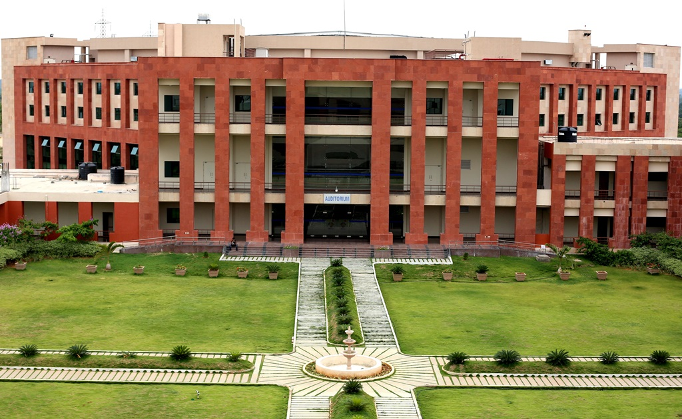
Principles of Programming Languages
(CS F301)
Jabez Christopher
Assistant Professor
Department of CSIS

Slide 2
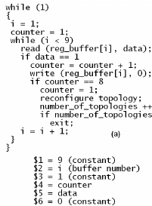
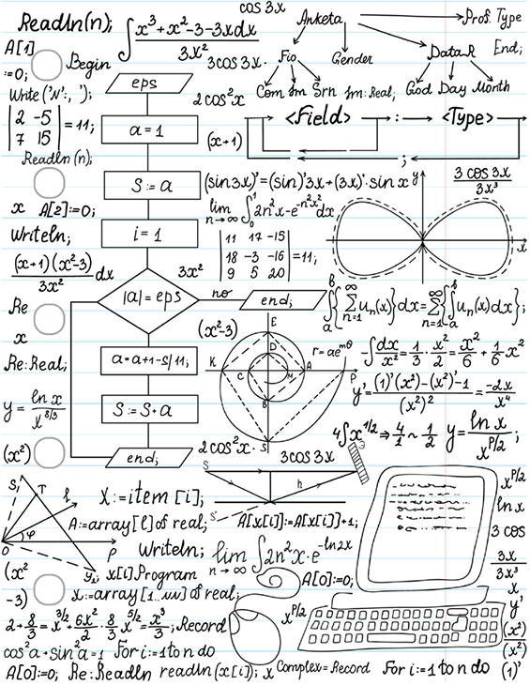
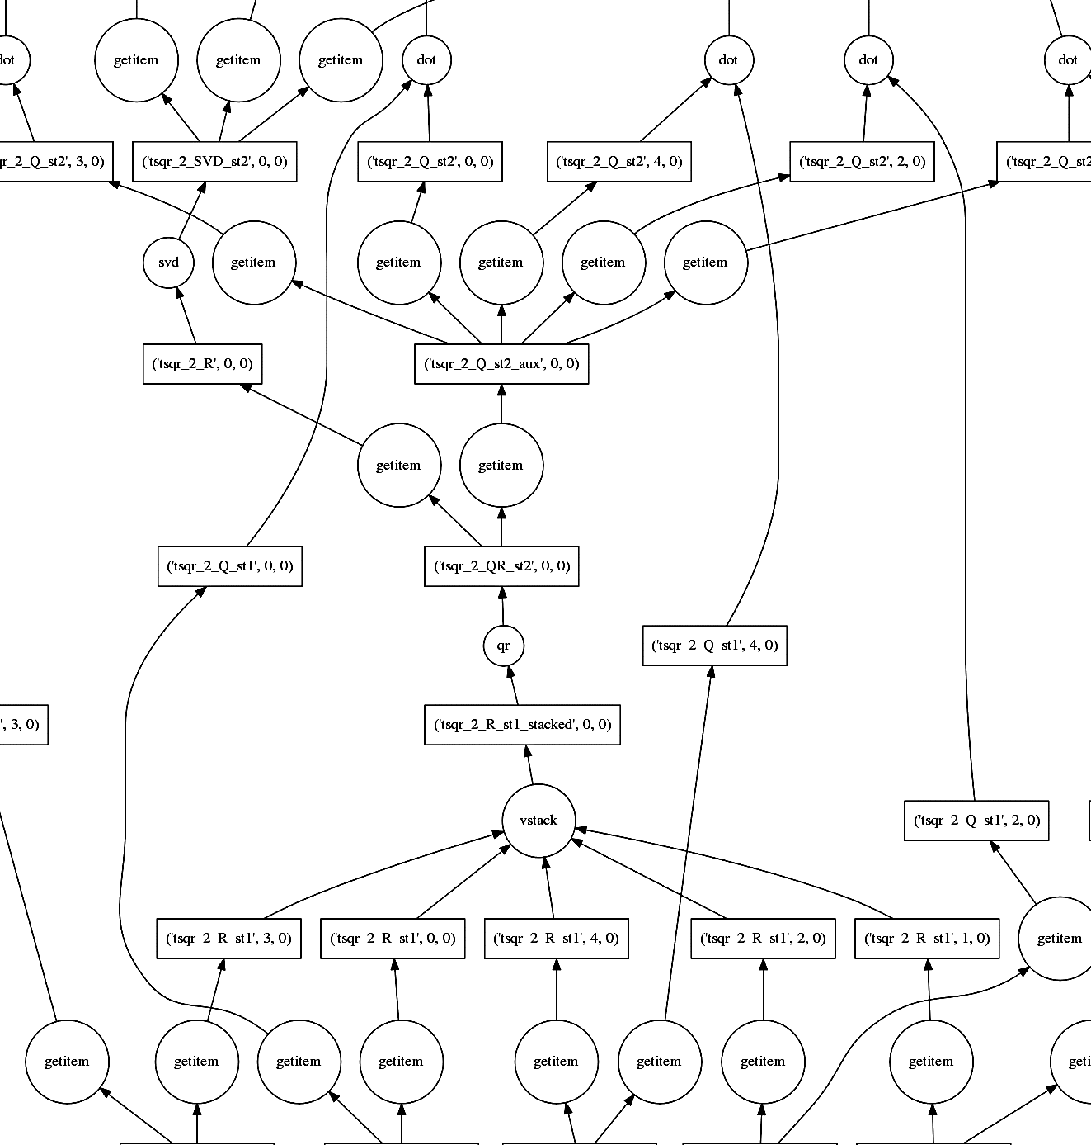

Slide 3
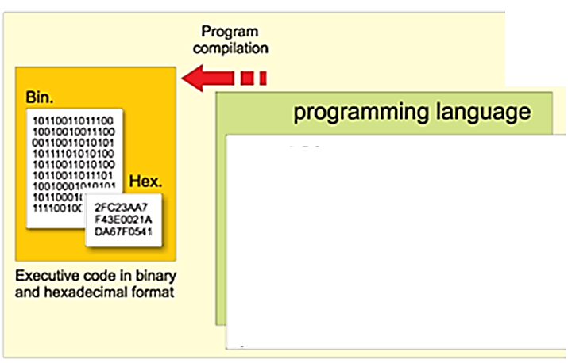
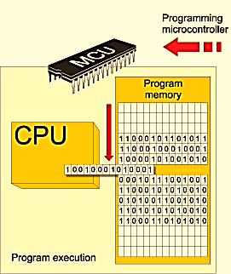

Slide 4
Motivation: Why Languages?
Increased capacity to express ideas
Improved background for choosing appropriate languages
Increased ability to learn new languages
Better understanding of the significance of implementation.
Better use of languages that are already known
Overall advancement of computing

Slide 5
Programming Domains
Scientific Applications
requires large numbers of floating-point arithmetic computations
efficiency is a primary concern
Business Applications
producing elaborate reports
ways of describing and storing decimal numbers and character data
ability to specify decimal arithmetic operations
database applications: Efficient search and updating
Artificial Intelligence
symbolic computation
ability to create and execute code segments during execution
logic programming
Modelling behaviour

Slide 6
Programming Domains
Systems Programming
low-level features that allow the software interfaces to external devices
special machine-oriented high-level languages for systems software on their machines
Web Software
markup languages
pervasive need for dynamic Web content
portability

